Slide 1

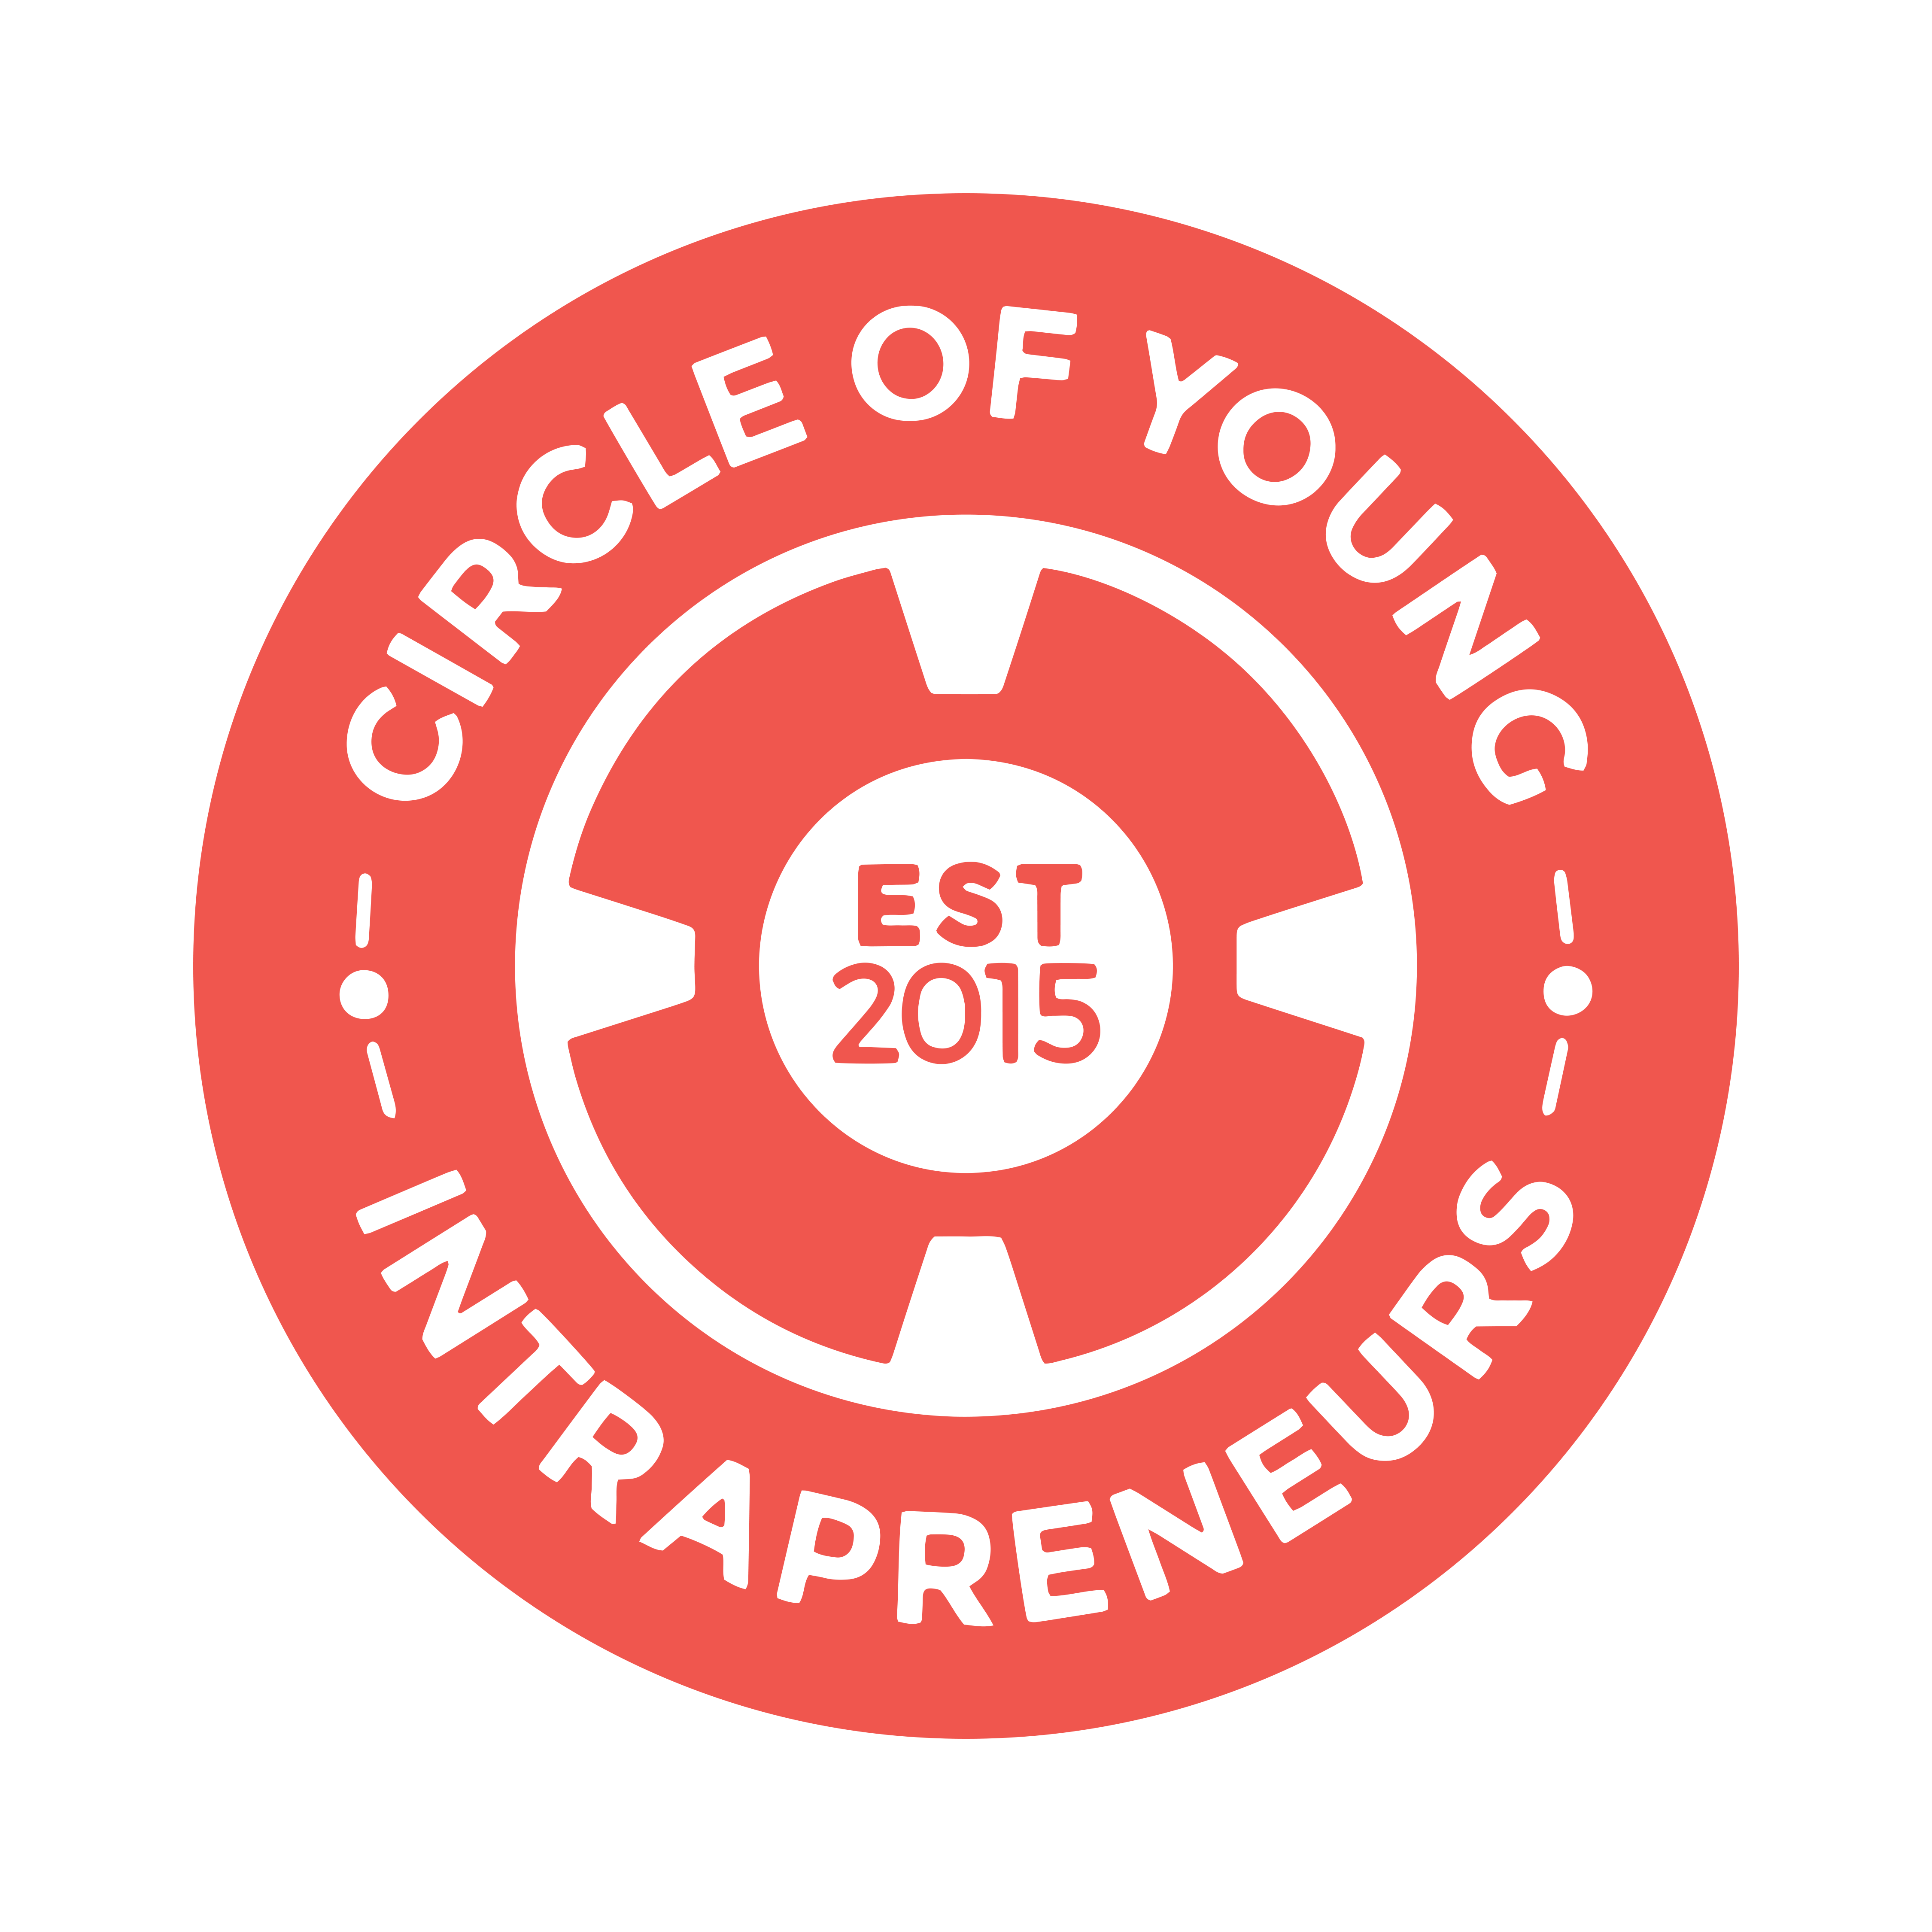
Circle of young intrapreneurs
2018 strategy

Slide 2
Our mission:
Who we are & what we do
We are a movement designed to inspire, guide, develop and deliver purpose-driven business ideas from social intrapreneurs in corporate organisations globally.
We’re making business a force for good.
We create positive social change through business by leading a community of changemakers. We support them to deliver with mentoring and advice from leading intrapreneurs, drive advocacy of the intrapreneurial agenda within corporates, and encourage collaboration to support the achievement of the sustainable development goals (SDGs).

Slide 3
Our 2018 goals
Our ultimate goal is to change the paradigm of business, making business a force for good.
To achieve this, we’re focusing on the following goals in 2018.
What’s our goal? |  | What outcomes are we seeking?
1. Drive advocacy of the intrapreneurial agenda within corporates |  | We want to promote widespread understanding of social intrapreneurship and the value it can bring to people, business and the world We want to understand who our members are, what they’re looking for, and how we can support them. And we want to empower them to help us spread the word about social intrapreneurship and the COYI We want the Circle of Young Intrapreneurs (COYI) to be the first organization coming to mind when people hear “social intrapreneurship”
2. Fuel the creation of profitably do-good initiatives in corporates around the world |  | We want COYI members to feel inspired and equipped to take initiative within their own corporates We want to expand our reach by providing all of our global Chapter Leads with the knowledge and tools necessary to support local intrapreneurs
3. Support the delivery of these initiatives |  | We want to provide consistent support to COYI members who have launched a social intrapreneurship project We want to track these projects and capture case studies which further fuel understanding and advocacy
4. Achieve our goals through a strong team and streamlined, sustainable operations* |  | We want COYI to be viewed as a great organization to work with, with an engaged and empowered team working together to achieve our goals We want COYI to operate like a well-oiled machine, with the ability to move swiftly and seamlessly We want COYI to be financially self-sustainable
*Internal goal only; will not be shared externally

Slide 4
Our 2018 strategy
To achieve our goals, we’ll prioritize the following key initiatives in 2018.
We’ve identified some initial success measures, which will be built out by respective project leaders.
What’s our goal? |  | How will we tackle it? | Types of success measures
1. Drive advocacy of the intrapreneurial agenda within corporates |  | Develop and disseminate thought leadership in the form of podcasts, publications and speaking arrangements to promote understanding and advocacy Conduct COYI membership analysis, segmentation and journey mapping, including key expectations and value propositions at each level Revisit and recommunicate the COYI mission and brand. Develop and implement an updated, proactive Comms strategy to effectively bring this brand to life Nurture selected partnerships to drive advocacy, understanding and visibility | Reach and engagement targets related to thought leadership and content Net promoter and/or brand health targets
2. Fuel the creation of profitably do-good initiatives in corporates around the world |  | Roll out new member onboarding program, updated in line with membership analysis Develop & deliver easily accessible trainings for (1) members and (2) Chapter Leads on how to launch and deliver a social intrapreneurship project Develop & roll out updated events guidelines including before- and after-care to ensure each event is driving one of our goals Develop chapter maturity model and target guidelines based on maturity levels | Completion rates for onboarding and training Event attendance Target # projects launched per chapter based on maturity
3. Support the delivery of these initiatives |  | Develop and implement project lifecycle model, including key support provided by COYI at each stage Finalize project tracking system and define KPIs which indicate success | 100% in-flight projects tracked along the project lifecycle
4. Achieve our goals through a strong team and streamlined, sustainable operations |  | Define and implement COYI people strategy Define and communicate COYI operating model, including key roles, responsibilities and processes Update and maintain technology and other operational tools to support Circle operating model Obtain sponsorship and funding for Circle operations | Feedback from team on people, operational and tech experience Funding secured

